Slide 1
Remember Architectural Basics
By the time you complete this power point you should be familiar with:
Architectural symbols: The language of architecture
Why are construction documents comprised of different views
Visual communication methods
Tools used by architects and designers

Slide 2
Architectural Symbols
The language of symbols offers a symbolic representation of building elements used on drawings showing their placement in relationship to other building elements.

Slide 3
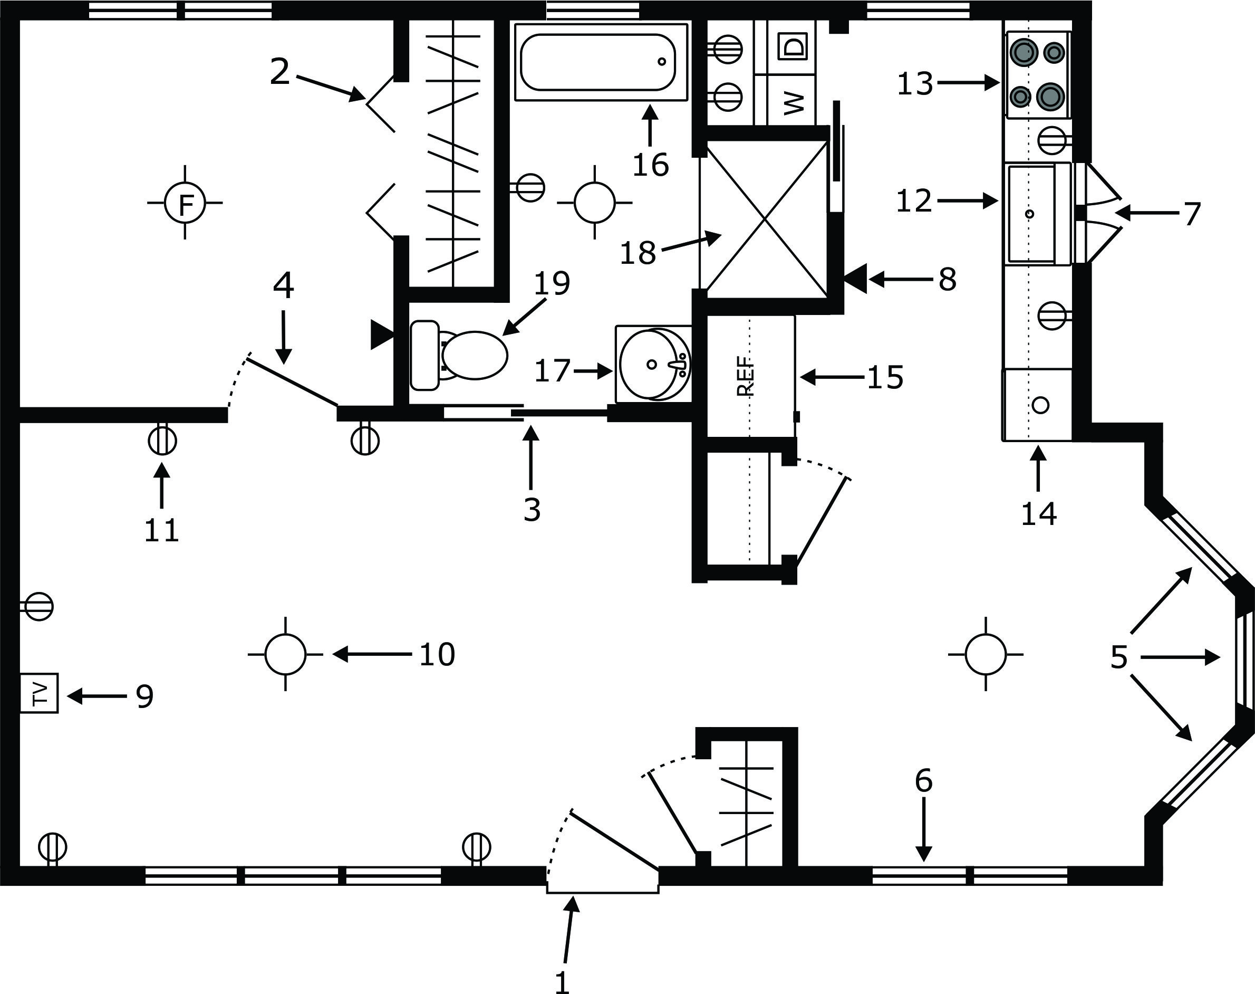
Floor plan with symbols

Slide 4
Construction Documents & Drawings
These views include:
Section Views
Detail Views
Floor Plans
Elevations
Set of documents that show details about the construction and design of the structure

Slide 5
Section View
A portion of a set of construction plans that shows a section or cut through of the structure. Imagine how a slice of a 5 layer cake looks. You see the layers and the frosting in-between. In a plan view, you see the composition of the floor, wall and roof framing systems.
“How would this be helpful for the person constructing the building?”

Slide 6
Section View

Slide 7
Detail View
This view shows a detail of the plan that has been magnified for closer inspection of the construction elements.

Slide 8
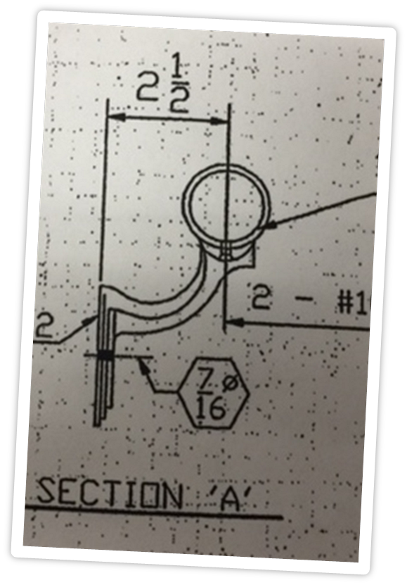
Detail View
What details are
made clearer with this detail view of a handrail for a theater?

Slide 9
Floor Plan
This plan shows the location of walls, windows, doors and fixtures in a structure
It is drawn from a birds eye or overhead view as though the roof had been removed.

Slide 10
Elevations
A 2-D drawing of a wall from floor to ceiling. It will include structural elements such as doors, windows and fixtures. There are also exterior elevations that show a single wall of the outside of a dwelling.

Slide 11
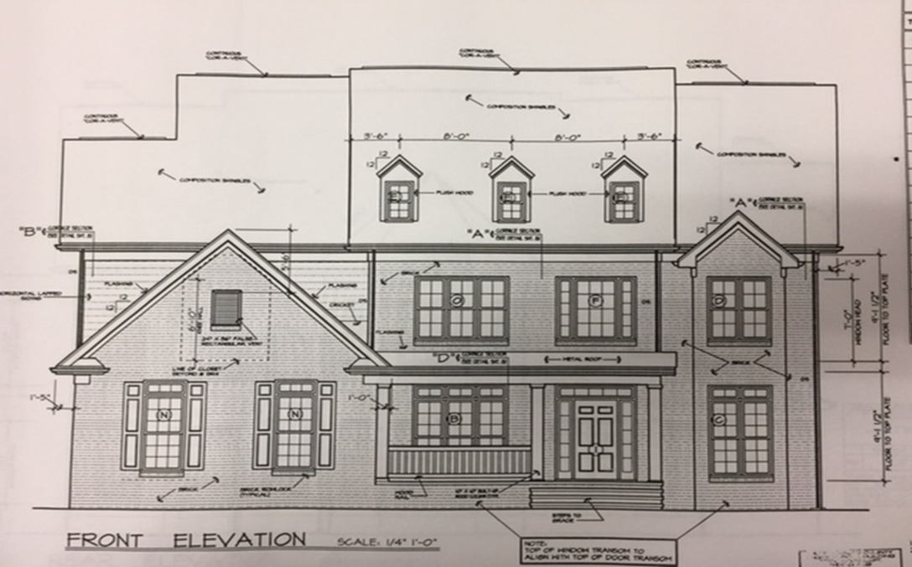
Elevations

Slide 12
Architectural Tools
These tools are used by architects, designers and engineers to create accurate plans for the construction of buildings. They include:
T-square
Triangle
Architectural Scale
Template

Slide 13
T-square (straightedge)
This tool helps designers when hand drawing to create accurate horizontal and vertical lines.
“As your teacher holds up the T-square, how do you think it works?”

Slide 14
Triangle
These tools are pre-calibrated at specific angles to aid the designer in creating accurate drawings. Adjustable angles are hinged for customized angle creation.
“How do you think you would use the T-square and triangle together to create accurate horizontal, vertical and diagonal lines?”

Slide 15
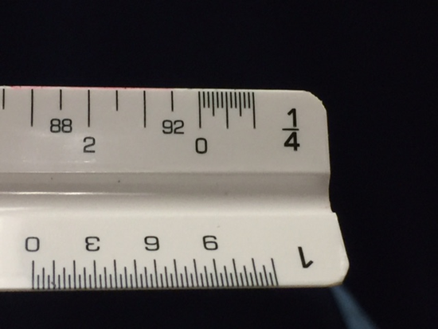
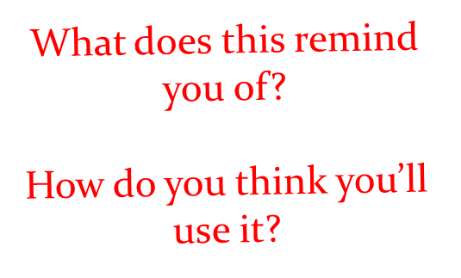
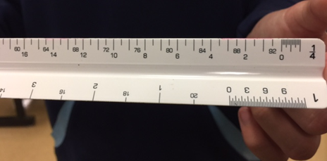
Architectural Scale
A measuring device calibrated at various scales to assist in the creation of scaled drawings. It consists of 12 scales.

Slide 16
Template
A thin plastic sheet with cutouts that can be traced to provide the accurate shape and size of objects to be drawn into a floor plan. There are several varieties that include:
Furnishings
Bath Fixtures
Kitchen Fixtures
Structural
“As you view a template, what does it remind you of? Ever traced letters using a stencil?”

Slide 18
Tracing Paper
A strong transparent used to create drawings, designs and tracing.
Often referred to as trash paper.

Slide 19
CADD
Computer aided drafting and design
This type of software speeds the process of creating plans that are accurate and industry accepted. Modifications are easy to make and many have a 3-D option for viewing the drawing in perspective.

Slide 20
Types of CADD programs
Consumer friendly versions that are free on-line:
Ethan Allen
West Elm
Bassett
Pottery Barn
Homestyler*
Roomstyler
Room Planner*
Floorplanner
Cool House Plans
ePlans
Fenton Commercial Plans
House Designers
Southern Living House Plans
Stockton Designs
The House Plan Shop
IKEA
*These versions offer more challenge to the user
Professional versions:
Revit
AutoCad

Slide 21
Architectural Renderings

Slide 22
What is a rendering?
The visual enhancement of any drawing through color, value, and texture.
Notes:
Bring a three-dimensional human quality to two-dimensional objects

Slide 23
What do renderings do?
Offers the client the ability to visualize what the space will look like before actual construction begins.

Slide 24
What should you render?
You can render just about anything.
Floor plans, wall elevations, and exterior views of a home are popular renderings.

Slide 25
Rendering Media
Most popular rendering media include:
Colored pencil
Graphite pencil
Watercolor
Felt-tip markers

Slide 26
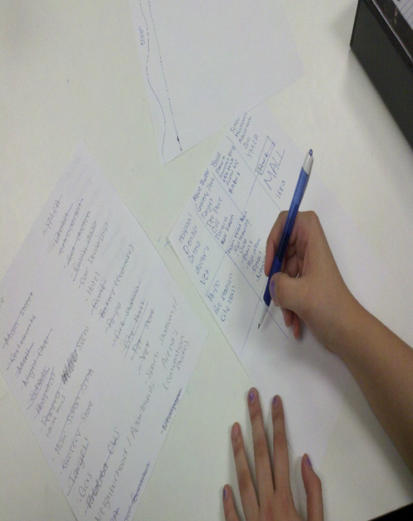
Note to me: I think I’m ready to learn more since I know about the basics!!!
so…What’s next?

