Slide 1
How to create Hues and Variations in Microsoft Word
FI51 – Obj. 2.02

Slide 2
This Powerpoint explains how to create a hue and its variations in Microsoft Word. For students with growing up in the digital age and with access to computers this can be a valuable tool in helping them understand and visualize hue, tint, shade and tone.
This is also referenced in the box at the bottom of the Hue Knew assignment from the curriculum.

Slide 3
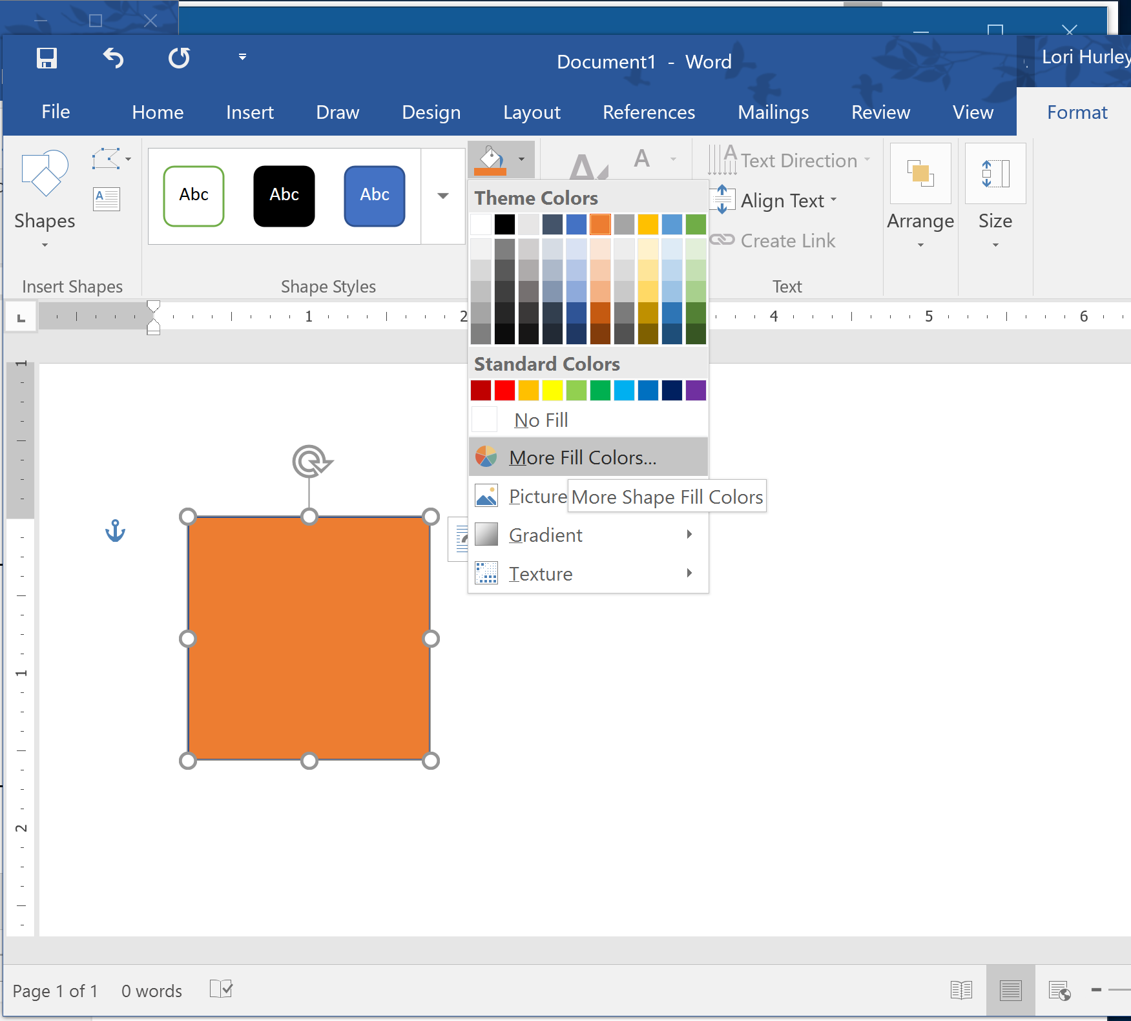
Highlight one of the colored squares. Go into Drawing Tools or Format, click Shape Fill or paint bucket icon, then More Fill Colors…

Slide 4
In the small window that opens click on the custom tab and it will look like this…
You will see the current color displayed in a box to the right.

Slide 5
1.
To create a hue:
1- Drag the cross icon to the top of the color spectrum chart
2- Move the arrow on the side bar to the middle.
Notice there is a new color showing since the original was not a hue.
2.

Slide 6
To create a tone:
1- Drag the cross icon straight down the color spectrum chart, leaving the side bar arrow in the middle
Notice there is a new, duller color or tone showing at the bottom.

Slide 7
1.
To create a tint:
1- Leave the cross icon at the top of the color spectrum chart
2- Drag the arrow on the side bar towards the top
Notice there is a new, lighter color or tint showing at the bottom.
2.

Slide 8
1.
To create a shade:
1- Leave the cross icon at the top of the color spectrum chart
2- Drag the arrow on the side bar towards the bottom.
Notice there is a new, darker color or shade showing at the bottom.
2.

Slide 9
Notice you can have a color that is both a tone and a tint
Or…
A tone and a shade.

Slide 10
Once you have created the color you want, click OK and the color will be added to your color palette for this file.
Most people would call this new color PEACH, now you know it is a TINT of the hue ORANGE. ☺

