Slide 1
color Selection
Obj. 2.01 - Color

Slide 2
Factors in color Selection:
Client preferences or needs
Psychological and physiological effects
Culture
Trends and style
Perception of the space
Available light
Room size
Adjoining colors
Texture of colored surface

Slide 3
1. Client Preferences or needs:
Designers must choose colors that are preferred by the client rather than focusing on our own color biases. Consider:
Psychological associations (personal experience)
A lot of people think yellow is a happy color, Van Gogh thought it the color of pure evil
Culture
Color can have very different associations depending on culture
Trends & style
Certain styles use particular color families (jewel tones used in Traditional style)
Color forecasting services predict colors that will be popular in the near future

Slide 4
2. Perception of the space
Designers must also consider the space where the color will be used including:
Available light
Room size
Adjoining colors
Texture of colored surface

Slide 5
A. Available light
Orientation of the room to sunlight
Amount of sunlight in space
Color of electric light in the space
Paint should ALWAYS be viewed in the room where it will be used before making a color decision!
Insert picture of the same paint color as viewed in different lights

Slide 6
A. Available light
Location of the color in the room will affect how light changes the color:
- Walls, floor, ceiling
Insert picture of paint color appearing different on walls/floor/ceiling
Paint chips should be held for viewing at the same angle the color will be in the room – ie: vertically for walls

Slide 7
B. Room Size
Warm colors and dark colors can make larger rooms seem cozier
Cool colors and light colors can make small rooms seem larger
Insert picture of a large room in warm colors
Insert picture of a small room in cool colors

Slide 8
C. Adjoining colors
These paint colors work together as well as with the countertops, flooring and wood.
Colors have relationship to each other and our perception of color is affected by nearby colors. Consider:
Any items that will remain in the space (furniture, flooring, etc.)
Colors found in rooms that are visible from the space being considered
Insert picture of room utilizing colors from an item, furniture, floors, etc…
Insert picture of adjacent rooms with similar colors
Using colors from adjacent rooms as accents in the space helps create a cohesive feeling in the home.

Slide 9
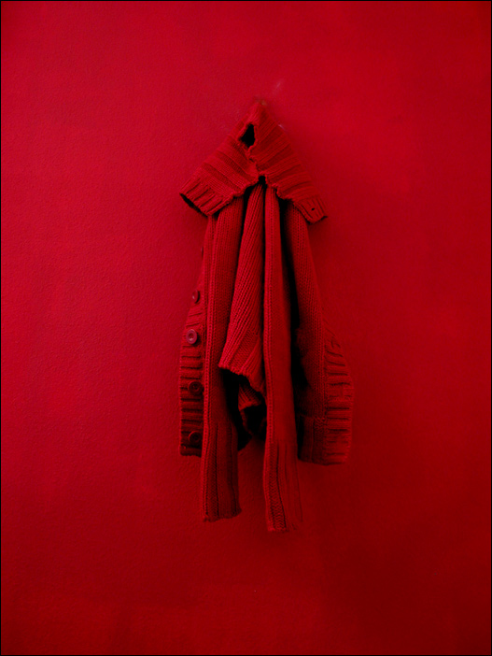
D. Texture of colored surface
These paint colors work together as well as with the countertops, flooring and wood.
Texture of the colored surface affects our perception of the color.
The same color will appear:
Lighter on smooth surfaces because they reflect more light
Darker on softer, plush or rough surfaces because they absorb light
Insert picture illustrating how the same color looks different on smooth/rough textures.
It can be difficult to match color when it is used on different surfaces due to differing reflectance.

Slide 10
Tips for Color selection:
Brighter colors are best in smaller amounts (accent wall, accessories, etc.)
Duller colors do not demand as much attention, allowing the eye to move around and visually expanding a space.
Bright colors draw attention. They will appear brighter against neutrals.
Warm colors (reds, oranges, yellows) seem to advance and grab attention. They can make a large area seem cozier or objects seem larger or more noticeable.
Cool colors (blues, greens, purples) seem to recede and can make a small area seem more expansive or make an object seem smaller or less noticeable.
Red increases the perception of time spent in a room, while blue decreases this perception.

Slide 11
Tips for Color selection (continued):
Neutrals can be light or dark as well as warm or cool in a space.
Using the same color on unlike objects or patterns can unify them.
White interiors can seem sterile and uninteresting. Using wood (brown tones) can add warmth and a human element to the space.
The higher the hue contrast between colors used the stronger the statement. Colors farther apart on the color wheel have greater hue contrast. Complementary colors have the greatest contrast in hue.
Plenty of neutral elements used with brights or high contrast hues offers the eye a place to rest.
Remember, none of these tips exists in isolation. They all work together and can enhance or diminish each other.

