Slide 1
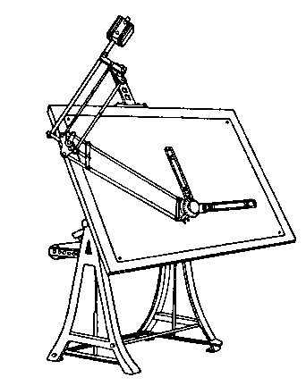
Careers in the Industry
Housing and Interior Design

Slide 2
Real Estate
Real Estate Developer – plans and creates new building projects
Appraiser – sets the value on a property
Real Estate Clerk/Agent – help clients buy, sell, rent, and lease property

Slide 3
Design
Furniture Designer – designs furniture based on current trends and historical influences
Interior Designer – plan and supervise the design and arrangement of building interiors and furnishings.
Protect the health, safety, and welfare of the public

Slide 4
What’s the Difference? Interior Designer vs. Interior Decorator
Interior decorator : generally refers to someone who deals with finishes, surfaces, furniture, and wall coverings.
An interior decorator: may work in a variety of venues from a design showroom to a redecorating a house.
There is no government regulation regarding the work of an interior decorator.
Interior designer: is a more specialized career field, requiring a certain combined level of education, work experience, and licensing.
An interior designer: may create spaces for the inside of a commercial office building, design the lighting for a restaurant, or select the furnishings of a home. An interior designer may also deal with issues of safety like accessibility and building codes.
The most important skill for an interior designers is…
CREATIVITY!!!!

Slide 5
Home Construction
Architect – design buildings to satisfy people’s needs.
Ensure that the proper codes are met and the correct materials are used by the contractor and builders
Copy… 5year course in college
Contractor – works with the architect and interior designer to complete a project. Usually sub contracts for trade specific jobs

Slide 6
Home Construction
Carpenter – builds the frame of the house. They also install the windows, doors, cabinets, stairs, and paneling.

Slide 7
Trade Specific Industries
Electrician – install wiring and repair systems
Masons – lay foundations of concrete
Plumbers – install pipe systems to carry water, steam, and gas.

Slide 8
Memorize…
ASID= American Society of Interior Designers
ASID= Organization that certifies interior designers.
http://www.asid.org
Find lots of information:
Managing & Marketing Your Business
ASID Contract Documents
Practice
Products for Designers
Codes & Standards
Aging & Accessibility
Design Research
Professional Development
Conferences & Expos, and much more

