Slide 1
Technological Advances in Home Design
7.05

Slide 2
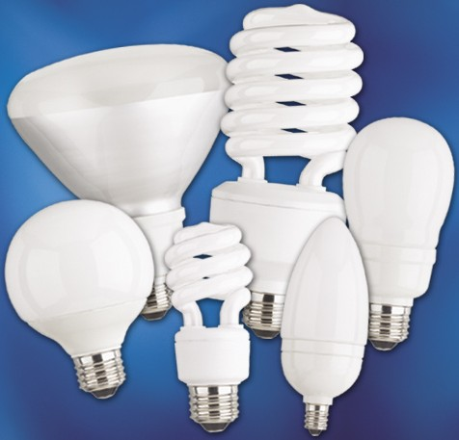
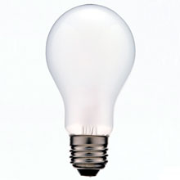
Lighting
There are several newer more efficient light choices available today.
Fluorescent Bulbs are more energy efficient
Incandescent Lighting has been the traditional lighting source used for the past 100 plus years.
7.05

Slide 3
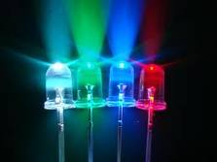
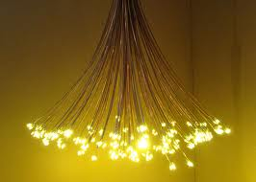
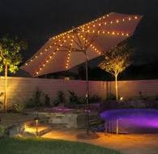
Lighting
LED – Light Emitting Diode lighting is currently the new trend in home lighting. LED lighting is highly versatile and low in power cost. LED lighting uses silicon chips and can last 100,000 hours or more. These lights use 1/4th the electricity but can last 10 times longer.
7.05

Slide 4
Plumbing
Plastics have replaced most traditional copper water lines. Pex plumbing is a flexible plastic line ideal for new home construction and for replacing plumbing in an older home.
The greatest advantage of plastics is that they are lightweight, easy to install and because of their flexibility can be formed into nearly any desired shape.
7.05

Slide 5
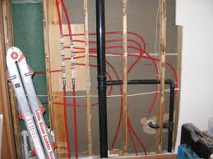
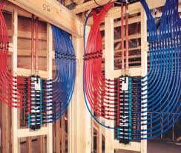
Plumbing
Pex
7.05

Slide 6
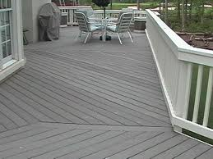
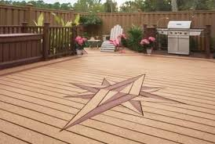
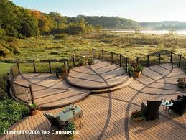
Plastic Lumber
Plastic lumber can be used to build a deck that never needs painting and has very low maintenance.
One such example would be a deck built from Trex. Trex is made from plastics and sawdust.
7.05

Slide 7
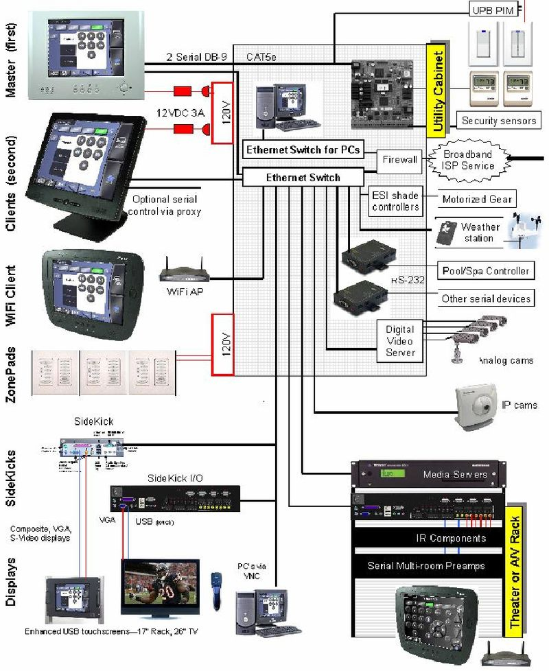
Automated Management Systems
Automated Management systems oversee daily functions from one central unit.
This particular unit shown can go so far as to turn on and off your Jacuzzi. It can also control your home security system, thermostat, television, lighting and any appliance in your home.
7.05

Slide 8
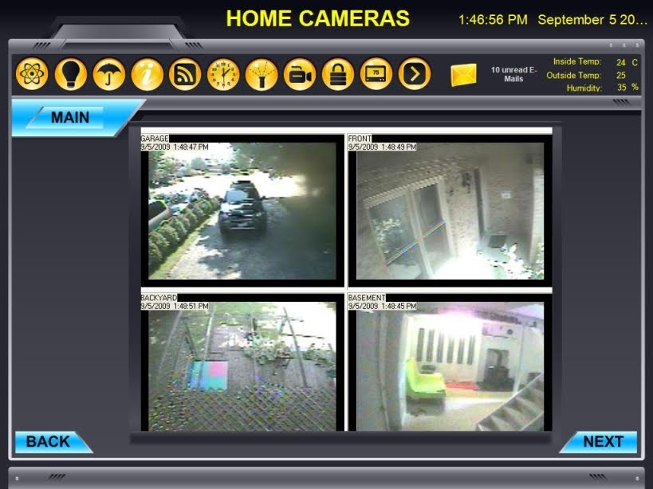
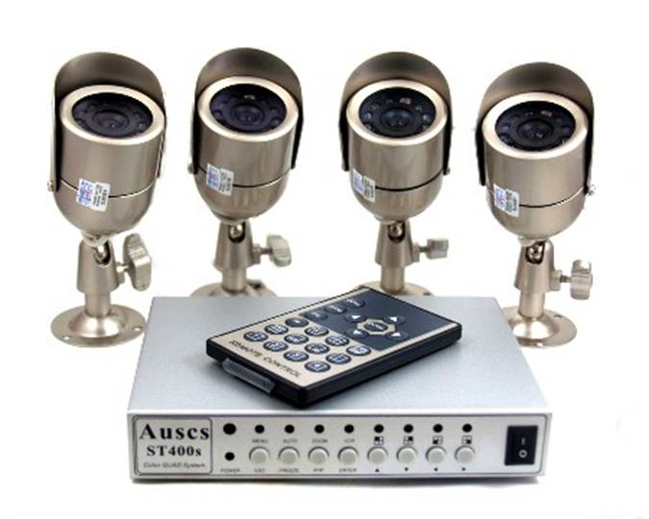
Closed Circuit Television
This system uses carefully placed cameras to see what is occurring in and around different areas of your home.
7.05

Slide 9
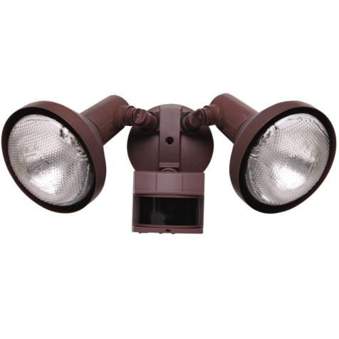
Motion Sensors
lighting that uses a sensor to turn itself on when movement is detected
7.05

Slide 10
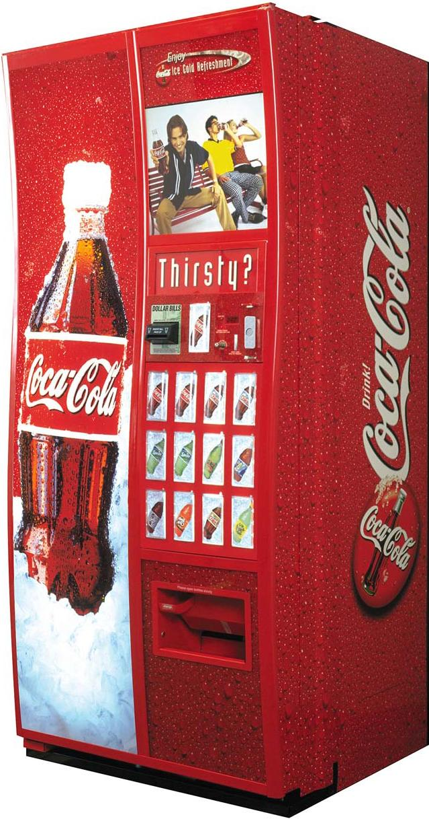
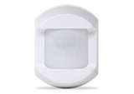
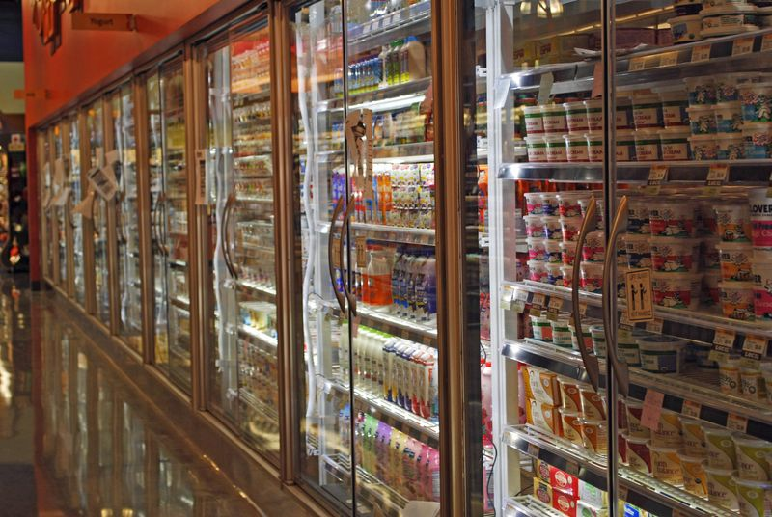
Motion Sensor Use
Soda Machine and grocery Stores also use this technology for saving energy as well as drawing attention to their products.
7.05

Slide 11
Biomaterials
Biomaterials are organically based building materials manufactured from recycled materials.
Examples of Biomaterials are:
Recycled Bricks-Bricks that are moved from demolition to reuse on a new structure.
Glass crushed to make floor tiles
Tires shredded and dyed to make playground and yard “mulch” chips
7.05

