Slide 1
1.03
Demonstrate job seeking skills
Interior Design II

Slide 2
Outline
• Job seeking skills
• A. Applications
• B. Resume
• C. Cover letter
• D. Interviews
• E. Follow-up letter

Slide 3
Job Application Guidelines
1.Always use a blue or black ink pen that
you take with you. Never use pencils or gel pens.
2.Read the entire application carefully
before writing anything on it.
Make sure you understand the directions. Think through your answers before writing them. Make sure
all answers are honest and accurate.

Slide 4
Job Application Guidelines
3.Answer all questions. Do not leave any
blanks.
If a question does not apply to you, write “NA”, “None Applicable” or draw a line in the space.
NA

Slide 5
Job Application Guidelines
4.Spell correctly. You may carry a pocket-sized
dictionary with you.
5.Take a personal fact sheet with you.
  The fact sheet should contain the name, title,
  address and telephone numbers of at least
  three references. References should not be
  family members.

Slide 6
Job Application Guidelines
6.Desire Salary–
  always put “negotiable”
  or “open for discussion”
7. May we contact your present
employer?
• YES!
  – if you are currently working, you may not want
  your current employer to know you're looking.
  So checking "no" in this case is perfectly
  acceptable and understandable.

Slide 7
Online Job Applications
Use Spell Check
Re-read all your answers
Make sure all boxes/pages are filled out
*Attach resume*

Slide 8
References
• Ask them First!!!
• Do not pick family members
• Think about what that person would say
about you
• Think how long have I known this person?

Slide 9
Homework
• Ask 2 teachers permission to use them as
a reference.
– Use their email and the school phone number
• Ask 1 teacher for a letter of recommendation.. Does not have to be sealed. This will go in your portfolio.
Due in one week.

Slide 10
Applications -classwork

Slide 11

Why a good resume is important….
It’s your personal marketing piece
Its purpose is to get you an interview

Slide 12
Successful resumes….
are tailored for each occupation or job of interest
focus on employer’s needs
show how your qualifications/skills fit requirements of job
highlight specific achievements, increases in responsibility, work-related skills

Slide 13
Resume Tips
1.Should be only one (1) page long.
2. Typed neatly on 8 ½ X 11 white or off-white, quality paper using a font
that is easy to read and sized 12-14.
3.Name and address should be the most obvious information on the page.
4.Leave out personal information. Examples: birth date, gender, marital
status, social security numbers, height, weight, religious choice, etc.
5.Organize it carefully. Information should be arranged chronologically
from the most recent then back.
  It can be organized as Functional – where Emphasizes skills not than job history
6.Use phrases or incomplete sentences that start with an ACTION verb.
7. Avoid abbreviations, contractions, short hand. Make sure all spelling,
grammar and punctuation is perfect.
8. Be precise without writing paragraphs.
9. Avoid being wordy.
10. Make strong statements that are relevant to the information you feel best represents your qualifications for the job.
Clear and easy to read.

Slide 14
Examples of action / power verbs
Administered
Analyzed
Budgeted
Collaborated
Communicated
Compiled
Completed
Conducted
Consulted
Contributed
Coordinated
Created
Demonstrated
Designed
Developed
Planned
Presented
Prioritized
Produced
Researched
Reviewed
Scheduled
Shared
Supervised
Supported
Trained
Updated
Worked
Wrote
….
Distributed
Documented
Enhanced
Established
Expedited
Facilitated
Generated
Improved
Implemented
Initiated
Investigated
Led
Managed
Organized

Slide 15
Resume basics include:
Identifying information
  Name
  Address
  Phone number
  Email address

Slide 16
Resume basics include:
Objective (optional)
  Concise statement specifying position, field of work, or skills to be used on the job
  Near top of resume
Example: “Receptionist position using my customer service, administrative, and communication skills.”

Slide 17
Ask yourself…
What information about me is most relevant to the job I’m applying for?

Slide 18
Resume basics include:
Education
  Relevant training, certifications, schooling
  Start with most recent
  For each school, list name, location, diploma/ certificate/degree earned, date of completion
  If not completed, use “expected” plus date, or “in progress”

Slide 19
Resume basics include:
Work/Experience
  Names and locations of organizations
  you’ve worked for, starting with most recent
  Years worked there
  Job title
  Main duties performed, results achieved
  Relevant volunteer activities, internships, projects (especially if little paid experience)

Slide 20
Resume basics include:
Relevant skills / abilities (optional)
  If you have specific computer, foreign language, typing, or other technical skills (e.g. equipment operation), consider listing these in a separate section

Slide 21
Resume basics include:
Activities / associations (optional)
  Include participation in organizations, associations, student government, clubs, or community activities, especially if related to position you’re applying for

Slide 22
Resume basics include:
Awards / honors (optional)
  Any formal recognition you’ve received
  Professional or academic awards (if not listed in education or work experience section)

Slide 23
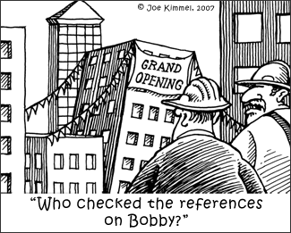
Resume basics include:
EITHER “References available upon request” statement
OR separate document with references listed

Slide 24
COVER LETTER

Slide 25
CREATE!!!- First project
Resume versus Designer Resume
1.Find a classified ad for a job in your future
Career.
2.Resume- Geared to your future Career 45pts.
3. Designer Resume- Geared to your future as
an Interior Designer/ Architect. 35 pts
4.Cover Letter-for job in your future career -
15pts

Slide 26
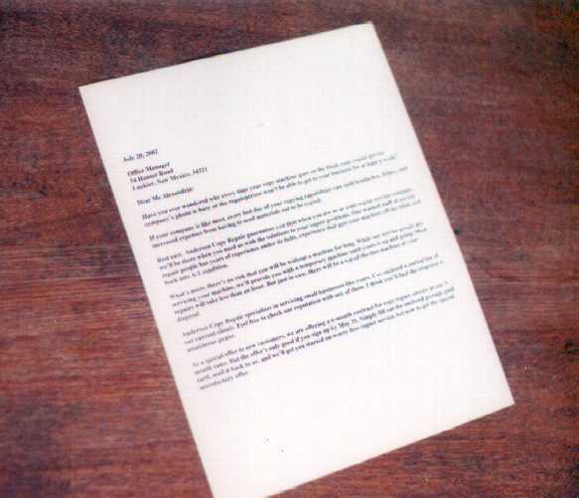
Cover Letters

Slide 27
Cover Letters
A cover letter should complement, not duplicate, your resume.
• A cover letter is often your earliest written contact with a
potential employer, creating a critical first impression.
• Effective cover letters explain the reasons for your interest in the specific organization and identify your most relevant skills or experiences (remember, relevance is determined by
the employer's self-interest).
• They should express a high level of interest and knowledge about the position.

Slide 28
Appearance
Match font used in resume
Readable font size (10-12 point)
One page or less
Paragraphs (opening, body, closing)
Use laser printer
Send along with resume OR as the body of an email or as an attachment

Slide 29
Cover Letter basics include:
Your contact information
Recipient’s contact information
Date
Salutation
Paragraphs
  Opening
  Body (“sell” skills/qualifications)
  Closing (request for action)
Signature
Enclosure

Slide 30
Cover Letter specifics:
Tailor to job for which you’re applying – different letter for each application
Discuss your qualifications for particular position
Use letter to demonstrate your communication skills
Don’t simply repeat resume, expand on it -- additional information; relevant, noteworthy accomplishments
Let job notice be your guide (see example next slide)

Slide 31
Cover Letter Basics- Summarizing…
A cover letter expresses interest and qualifications for a particular position
Personal but professional
Each cover letter will be different according to experiences, jobs, and applicants
Tailored to position/company. So, change it as you change the application.
Explains how you fit with organization and how you will help them
Expands main points from your resume
“Sells” qualifications to the prospective employer
Notes:
Key Concept: The facilitator should emphasize that a cover letter should make a student stand out from the rest of the applicants. Each cover letter will be different according to experiences, jobs, and applicants. Remind the tutors that although students may seem hesitant to make more than one cover letter, each cover letter should be tailored to a particular job or assignment to be most effective.
The tutor should also remind students that although a cover letter should highlight points from their resumes, they don’t need to put every single activity or skill in their cover letter. They should concentrate on “selling” the main points to the prospective employer.

Slide 32
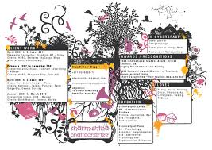
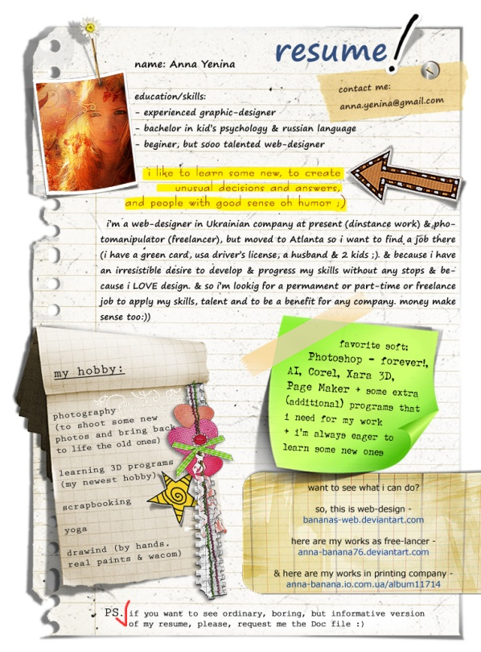

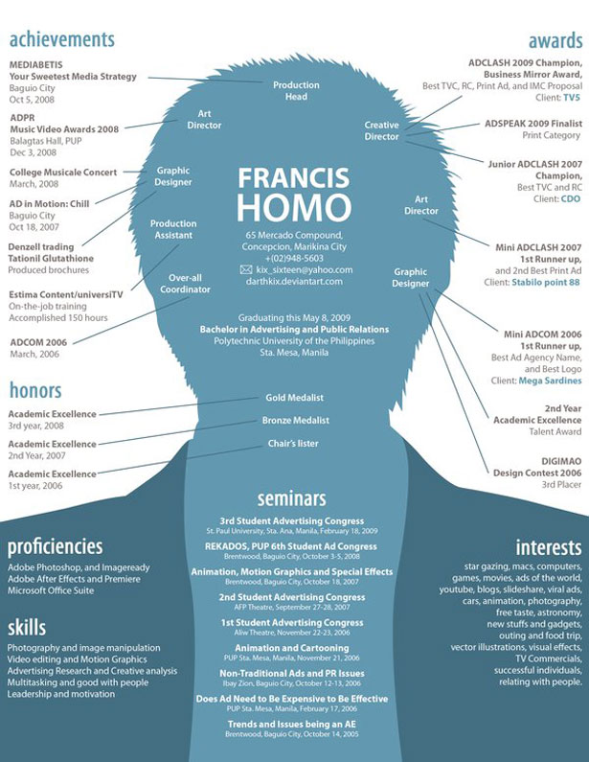
Designer Resumes!
Use all of the classes education
and your creativity.

Slide 33
Let’s start!!!!!

Slide 34

Interview Dress code…

Slide 35
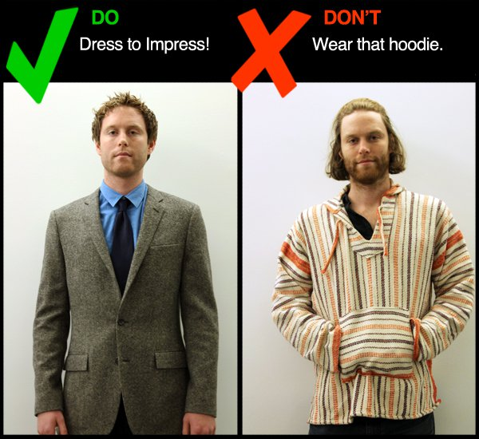
Interview Dress code…

Slide 36

Interview Dress code…

Slide 37
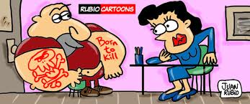
Interview Dress code…

Slide 38
In an Interview
• Do:
• Go alone to the interview.
• 1.Arrive 10 minutes early.
• 2.Dress well and appropriately for the
job with which you are applying. Hair
should be clean, tidy and away from your
face.

Slide 39
Tips…
Put together an outfit for everyday
• Put together an outfit for an interview.
• Money is not an issue…
• Dress for success!

Slide 40
In an Interview
Do:
• 3.Maintain good posture and eye contact.
Show enthusiasm and smile.
• 4.Give a firm handshake when meeting
the interviewer and wait until you are told
to be seated.
• Pay attention to your body language

Slide 41
In an Interview
Do:
• Emphasize positive things about yourself.
• 5.Be honest with your answers.
• 6.Preplan several questions that you can ask
when appropriate.
• Remain calm and alert to answer all questions.
• 7.Thank the interviewer for his/her time.
• 8.Send a follow-up letter

Slide 42

In an Interview
Don’t:
• Bring anyone with you to the interview.
• Arrive late.
• Wear excessive make-up, jewelry or
perfume.

Slide 43
In an Interview
Don’t:
• Ask about the salary.
• Hesitate to pause before answering a
question.
• “Bad Mouth” a former employer or past coworkers

Slide 44
In an Interview
Don’t:
• Talk a lot about your personal life or
appear as a “know it all”.
• Lack confidence.

Slide 45

Interview Questions
• 1.Tell me a little about yourself.
Answer: My name is Mary, I am currently a student at Everest Institute. I
currently work for Clayton county public school as a Nutrition Worker. I am
easy to get along with and I feel that I am a team player and will do whatever it
takes to get the job done
• 2.Give me an example of a time when you exercised leadership.
Answer: If you have no prior work experience, you could tell a short story on how
you used leadership skills to help organize a group project at school, or used
leadership skills if you are the captain of a sports team, or leader of the drama
club/etc.
• 3.How do you handle yourself in stressful
situation?
Answer:
I actually work better under pressure and I've found that I enjoy working in a
challenging environment. Or I'm the kind of person who stays calm under
pressure, and handles stress fairly easily.

Slide 46
Interview Questions
4.What is the biggest mistake you ever
made?
Answer: Everyone makes mistakes… try to answer with a small mistake and list examples of how you fixed it. Focus on the positive.. Like what you learned not to do in the future
5.What did you learn from this mistake?

Slide 47
Other questions…
1- Tell me why I should hire you for this job?
Answer: Compare the job description to your accomplishments and skills.. Talk
about your interest in the job.
2- What is your greatest accomplishment?
Answer: Use something that can relate to any part of the job you are applying
for…. Tell them how it would compare
3- Describe your ideal job.
Answer: Describe a job that would aline with the job you are applying for. Or talk
about personal goals you would like to meet.
4- What motivates you?
Answer: be honest. Use examples of past experience in school project or a past
job.

Slide 48

Essential Questions
Why is it important to write thank you notes?
What would be an inappropriate follow up for a job interview?
Can there be too much follow up after a job interview? Explain.

Slide 49
Ways to Follow Up
After a job interview, a follow up is important. For instance, a:
Hand-written thank you note
Typed thank you letter
Email
  Sometimes email is not appropriate. Use discretion.
Phone call

Slide 50

In this lesson, we will discuss how to write a hand-written thank you note.

Slide 51
Importance
Why should I write a thank you note?
  Demonstrate that you have good manners
  Show appreciation for the employer’s interest in you
  Reiterate your interest in the position
  Remind the employer about your qualifications for the position

Slide 52
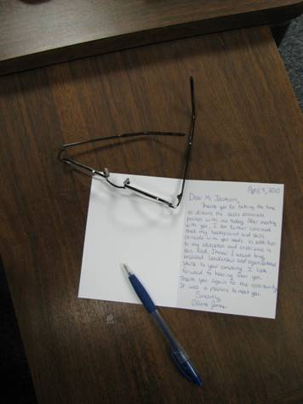
Importance
Handwritten notes are becoming rare as technology advances.
  They show that you took extra time and thought
  Handwritten notes are usually appreciated and get attention

Slide 53
Content:
How to Write a Thank You Note
Date/Greeting
  Write the date at the top, right hand corner
  Greeting Example: Dear Mr. Smith,
Express your appreciation (about one sentence)
  “Thanks for taking the time to meet with me about the account executive position yesterday.”

Slide 54
Content:
How to Write a Thank You Note
Express interest
  “The job seems like a very good match for my skills and interests. The strategies you outlined are just my style. I know I will be successful as well as enjoy the job.”
State why you are qualified
  List any personal qualities, education, and/or experience you have that will enable you to succeed in this position
  “In addition to my 8 years of experience in your industry, I will bring strong writing and leadership skills to your team.”

Slide 55
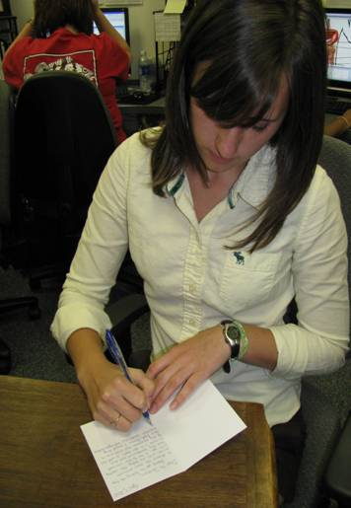
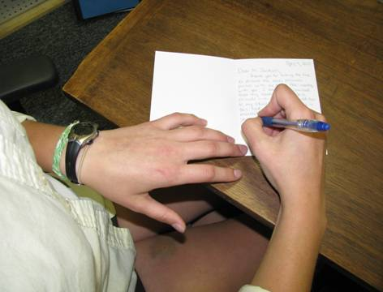

Slide 56
Content:
How to Write a Thank You Note
Closing
  Mention the future
    “I look forward to hearing from you.”
  Reiterate your appreciation
    “Thank you for your time and consideration.”
  Sign-off
    “Sincerely,
  (Your Name)”

Slide 57
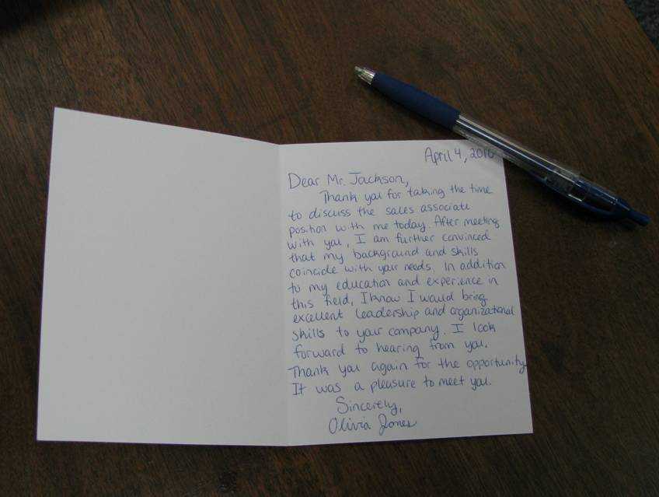

Slide 58
Revision
Proofreading over your note is extremely important
  Grammatical errors reflect poorly on your abilities
Write a draft of your thank you note first
Review the draft several times, checking for grammatical errors

Slide 59
Revision
Be sure to check the tone of your writing
If possible, have another person read over the note
  They may see mistakes you did not see
  They can give another perspective for improvements
Transfer your draft to the thank you note you wish to use and promptly mail it
Good penmanship is important!

Slide 60

Choosing a Thank You Note
It is important to buy good, quality stationery
  Personalized stationery looks very professional
Be sure to choose a thank you note that is appropriate

Slide 61
Other Reasons to Write a
Thank You Note:
When you receive a gift:
  Birthday, anniversary, Christmas, wedding, etc.
Award/Scholarship
When you visit someone’s home
  Dinner party
  Houseguest

