Slide 1
Family Types
Nuclear
Single-parent
Step/blended
Extended
Childless

Slide 2
Family Types
Nuclear family:
Mom, Dad, Children
Couple + their children (biological or adopted), possibly 2 incomes.
No children from a previous marriage

Slide 3
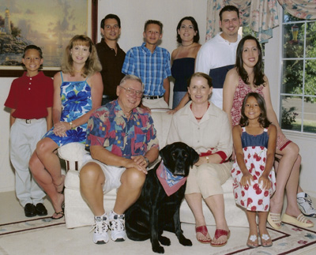
Family Types
Single-parent family:
Parent who raises child alone: usually because he or she is unmarried, widowed, or divorced
Blended/Stepfamily:
A family that is formed when separate families are united by marriage or other circumstance.
One or both have been married before
One or more children from a previous marriage.

Slide 4
Family Types
Extended family:
Two types:
Several generations: parents, children, grandparents, aunts, or uncles living together.
Same generation: brothers, sisters or cousins living together

Slide 5
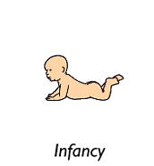
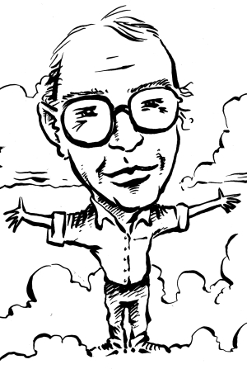
Life cycles
As Individual…
Infancy
Childhood
Youth
Adulthood

Slide 6
Family Life cycles
Stage 1: Beginning Family
The married couple establish their home but do not yet have children
Newly married
Make adjustment to married life and each other
Stage 2: Childbearing Family
From the birth of the first child until that child is 6 years old
Years for caring for preschoolers
Stage 3: Parenting/expanding
Children are in school
Caring for school age children and teenagers
Stage 4: Launching
From the time the oldest child leaves the family for independent adult life till the time the last child leaves
Stage 5: Empty Nest/ Mid years
From the time the children are gone till the parents retire
Stage 6: Aging Family
Retirement
One spouse lives alone after death of other (this stages increases as people live longer)

Slide 7
Family Stages
What family stage has the largest increase in population growth?
Aging

