Slide 1
1.02 - Factors to Consider when choosing a place to live

Slide 2
1.02 - Factors to Consider when choosing a place to live
MAIN FACTORS TO CONSIDER…..
1.HISTORICAL/CULTURE
2. SOCIETY
3. ECONOMICS
4. LOCATION
5. GOVERNMENT

Slide 3
Traditional/Cultural Factors
Traditional/ Historical influences in housing came from Native Americans, early colonists, and the periods of time 1600s—early 1900s

Slide 4
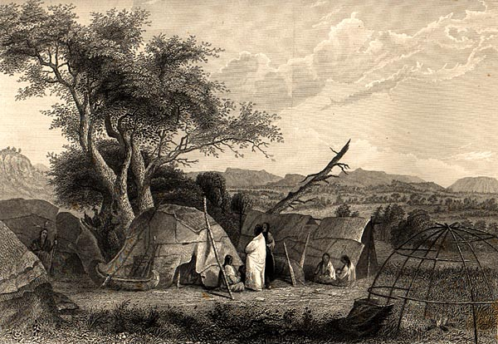
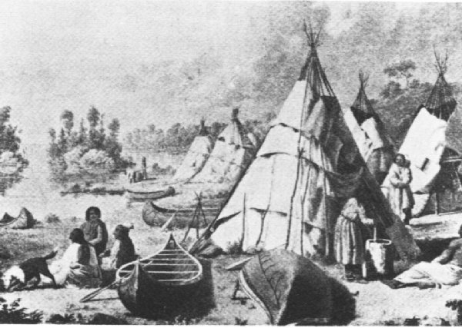
Housing of Native Americans
Wigwams
Teepees

Slide 5
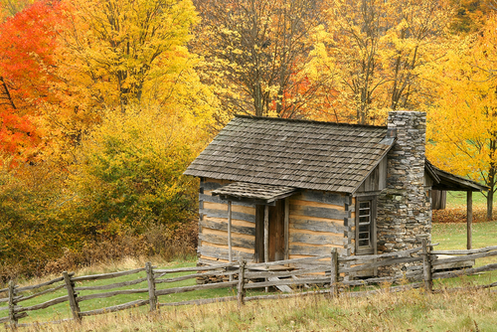
Housing of Colonist
Housing raising: help build the houses from neighbors
House was limited, due the lack of skills, materials and tools.
Ex: log cabin
Later… Log cabin became:
Larger
Variety of styles
2 stories
Fireplace
Houses were placed together for SECURITY reasons
Later: bricks and stones
Notes:
Os colonistas na primeira vez que chegaram eles copiaram o estilo dos indios nativos (casas) entao depois que eles se estabilizaram eles comecaram a copiar as casas da sa terra natal (homeland).

Slide 6
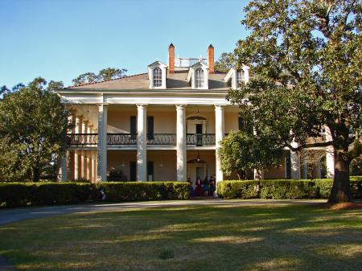
Housing 1700s and 1800s
Variety of dwellings
Large plots of land
Large plantation houses: common for large landowners of the South
Late 1700s:
  Most settlers were AGRARIAN
  By 1890 rural population due: Industrial Revolution
  People moved to cities: Urban housing
Notes:
Many people moved west, and settled on large plots of land (south0.

Slide 7
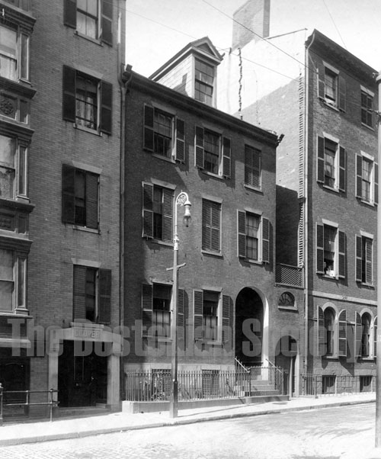
Housing 1700s and 1800s
Tenement houses= early apartment
Those appeared in New York City around 1840
Typical Tenement houses: 5 story building ( no housing regulations)
By 1890 Government
Regulations: every room
should have a window
Each apartment should have:
Running water, kitchen sink and
community toilets –located in the
stairway area connecting the floors
Row houses: a group of more
Spacious houses connected by
common sidewalls.
Conditions were very poor.

Slide 8
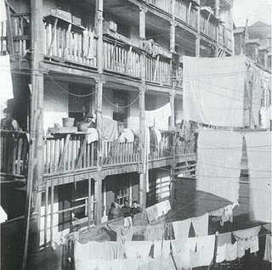
Tenement Housing

Slide 9

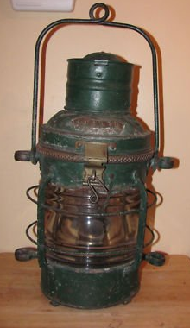

Oil & gas lamps replaced candles.

Slide 10
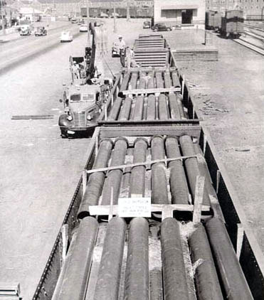
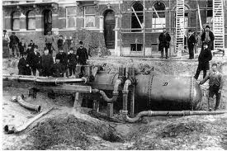
Water suplies, plumbing, sanitation facilities were improved.

Slide 11
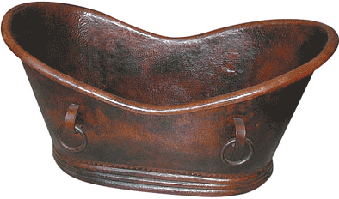
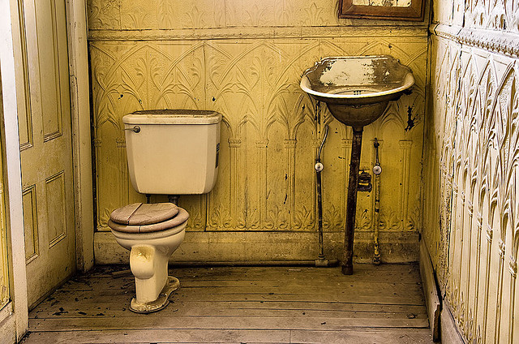
Some houses had indoor toilets and bathtubs.

Slide 12
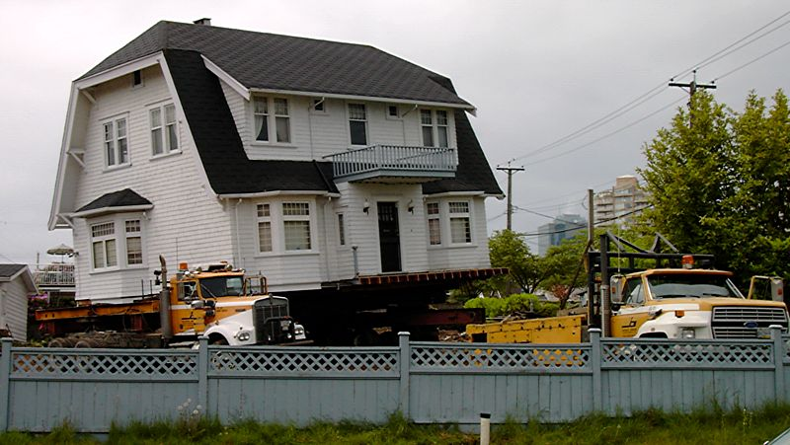
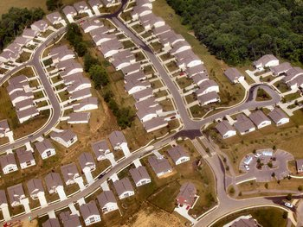
Housing 1900s
Solutions:
Factory-build houses
Houses unit on wheels
After WWII – Tract houses:
  GROUPS OF SIMILARY HOUSES BUILT ON A TRACT OF LAND.

Slide 13
Cultural Influences on Houses
Beliefs, social customs, and traits of a group of people
How cultural background of your family affect your home?
A person's gender, age, position in society, food, believes ,religion, individual preference , etc
Notes:
Native American tribes (traibes)believe that the door (front door0 of the house should be placed faced to east. It had religious significance’
Today we can see a lot of Spanish influences in our houses, and also French , British styles, etc.

Slide 14
Societal Influences on Housing
Household size
Affordable houses
People with disabilities
Older population
Planning leisure time
Working at home
Mobile society
Notes:
Signs
of societal change are everywhere…
Planning leisure time; more and more people are spending more time at work, so they must get time for leisure with a family, Ex Beach house, Mountain houses, etc
Mobile society : the main reason for people move from a place to other it is because employment reasons, others could be retirement, climate, etc,

Slide 15
Environmental Influences on Housing
Natural environment: Land, water, trees, solar energy, climate
  The constructed Environment: Includes the natural environment after it has been changed by human effort.
  Name: Frank Lloyd Wright- know for designed building blended with the natural environment

Slide 16
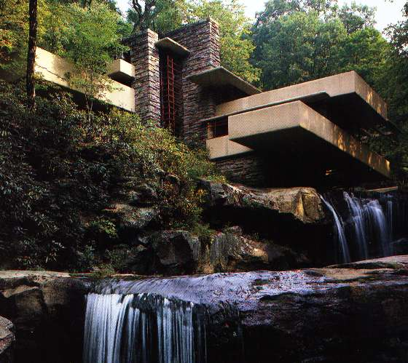
Frank Lloyd Wright

Slide 17


ECONOMY
HOW HOUSING is affected by the ECONOMY?
  Measuring the number of the families that can afford to buy a median-priced home in their area.
When the economy is down- number of housing falls
HOW MUCH HAS THE COST OF HOUSING INCREASED SINCE 1978?
  Tripled

Slide 18
Technological
Knowledge of tools, materials, processes and practical application of products used in housing
Technology changes over time as new and better ways of meeting human needs are discovered and created.

Slide 19
Technological Influences on the Housing
Early Technology
  Started from early cave dwellers to
    time the technology improved natural materials: windows, doors, handles, etc

Slide 20
Technological Influences on the Housing
Industrialization
  - Industrial Revolution_ big impact (goods were mass-produced and railroad system moved them efficiently.
  - prefabricated houses popular
  -Other Examples: Heat pumps, fans, automatic clothes washers, etc

Slide 21
Technological Influences on the Housing
High Tech
- Technology is also called high tech
- It has a big and growing influence on housing decision
- Computers, touch-pad microwave oven, ranges with safety lockers, voice activated command in using equipment, etc

Slide 22
Governmental Influences on the Housing
FHA (Federal Housing Administration) 1934
  OBJECTIVE: PROVIDE DECENT, SANITARY HOUSING FOR LOW-INCOME FAMILIES
  FHA: Federal Housing Authority: insures banks/lenders against the borrower defaulting on mortgage
  2. HUD (US dept of Housing & Urban Dev) 1965
  Cabinet level to provide decent, safe, sanitary for EVERY American
  Example: give assistance to the renters, if the owner of a house cuts water, sewer, etc.

Slide 23
Building Codes
Establish minimum standards for materials and construction methods, including plumbing, heating, ventilation, and electrical systems, roof styles & heights
placement of stairs and exits.
Constantly changing
Uniform Building Code most adopted model of building codes in world

Slide 24
Governmental Influences on the Housing
4. Zoning Regulations
  Governmental requirements that controls land use
  It specifies the type of buildings and activities that are permitted in certain areas
  Areas can be: residential, commercial, or industrial
  Example: Wal-mart would not be allowed to build a store in the middle of a residential neighborhood.
5. EPA (Environmental Protection Agency)
  The job is to safeguard the natural environment, including: water, air, and land
6. CPSC (Consumer Product Safety Commission)
  Take care about more than 15,000 consumer products used in and around the construction environment

Slide 25
7. ADA (American with Disabilities Act)
Covered businesses :
  restaurants, banks and commercial lending institutions, movie theaters, stadiums, grocery , schools and convenience stores, health care facilities and professional medical offices

