Slide 1
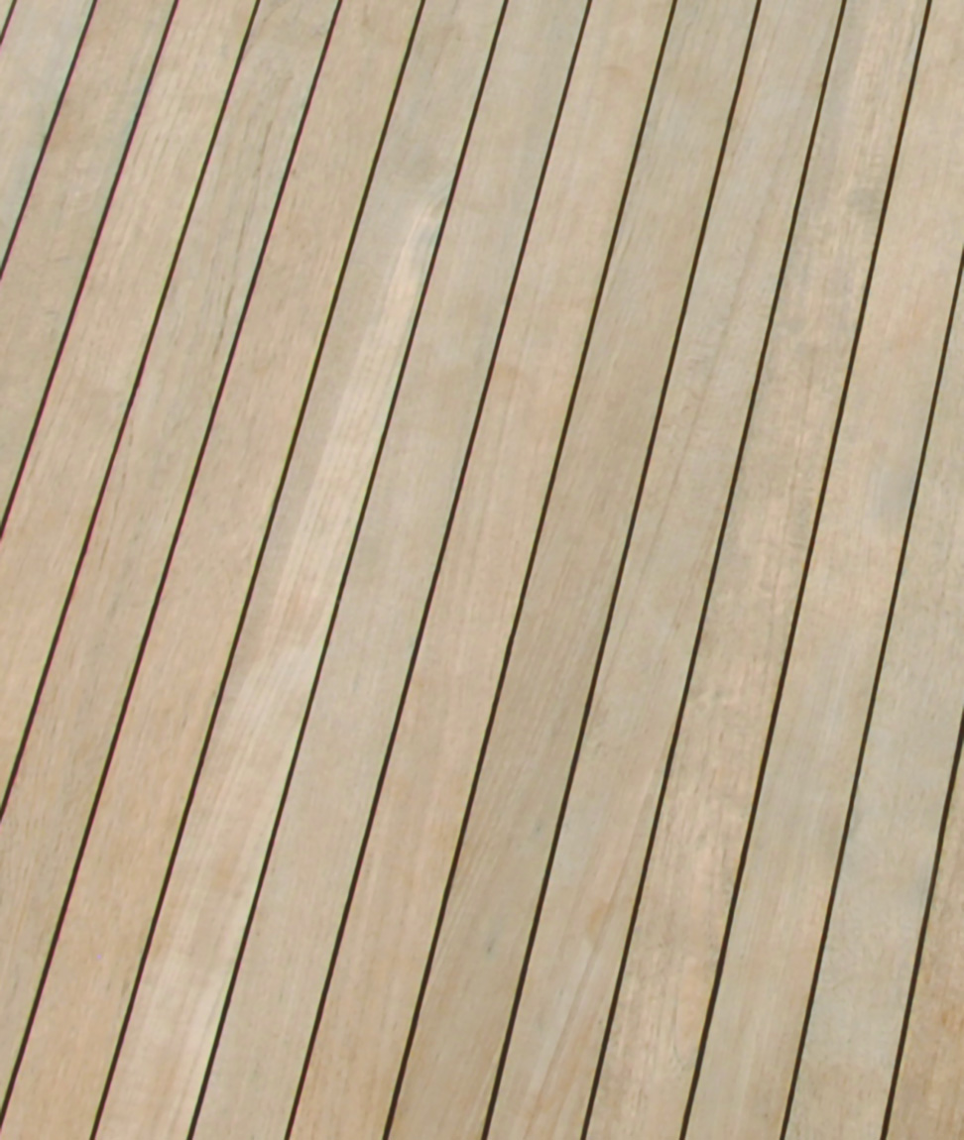
Classify floor coverings
Housing & Interiors I
FACS/ CTE/Cary High School

Slide 2
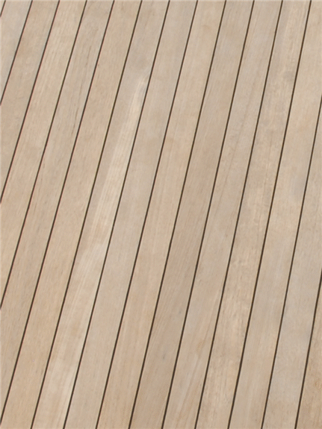
Classify floor coverings
A- Soft Floor Coverings
Carpets
Rugs
Pads/Cushions
B- Wood
C- Resilient Floor Coverings
Vinyl
Laminate
D- Tile
E-Calculations

Slide 3
Floor Treatments
One of the 1st backgrounds chosen for a room.
Floor treatments – consist of flooring materials and floor coverings.
Before choose a floor treatment, you should consider its appearance, comfort, durability, cost, and maintenance.
Flooring Materials – materials that are used as the top surface of a floor. They do not include the sub-flooring, but they are structurally part of the floor and are fairly permanent.
Common flooring materials: wood, tile, concrete, and brick.

Slide 4
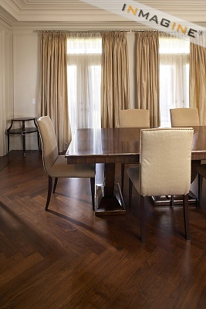
Wood
Has always been popular.
Looks good with all styles of furniture.
Offers beauty and warmth to a room.
Wood has some resilience (flexibility)and is durable, but can be scratched and dented.
Cost is moderate to high, depending on type and quality.

Slide 5
Wood
Hardwoods such as oak, hard maple, beech, birch, hickory, mahogany, cherry, and teak are common and are usually more expensive
Oak is most common because of its beauty, warmth, and durability.
Hard maple is also common because its smooth, strong, and hard.

Slide 6
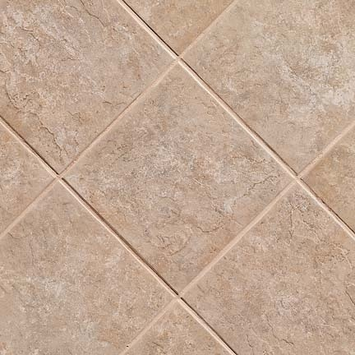
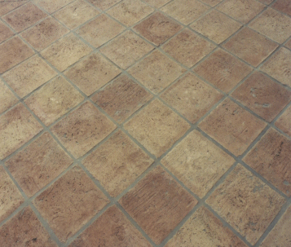
TILE
Tile is a flat piece of fired clay or natural stone that is available in a wide range of sizes, colors, finishes, and patterns.
It feels cool to the touch and is more popular in Sunbelt areas than in colder climates.
Primary choices for residential use are ceramic, porcelain, natural stone and quarry.

Slide 7
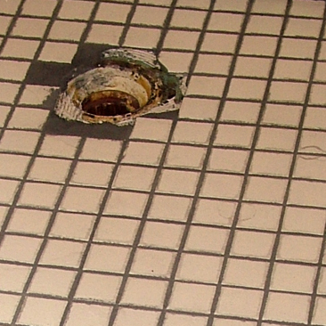
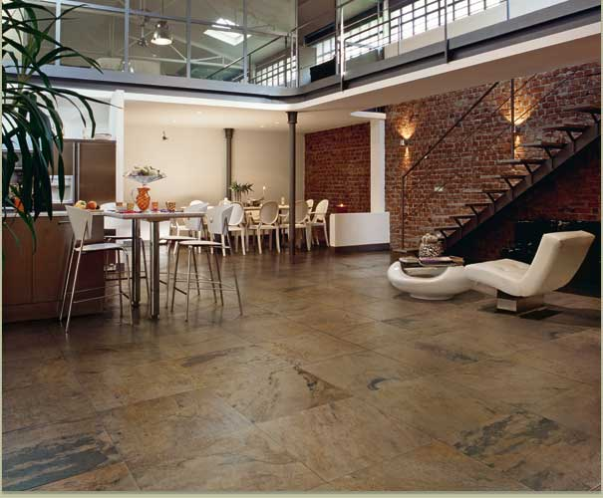
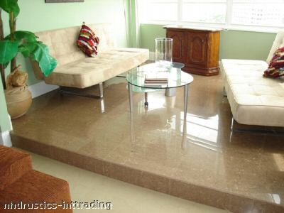
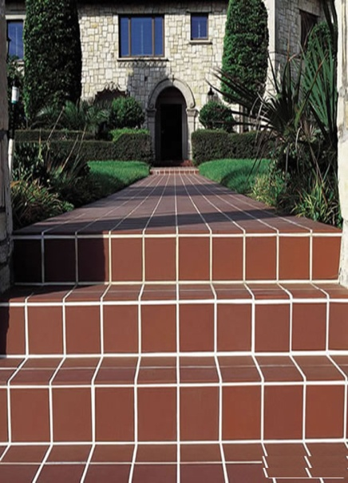
Types of Tile
Ceramic tile – is a flat piece of fired clay coated with a protective glaze.
High-quality ceramic tile is harder, more durable and more expensive.
Porcelain tile – is the highest quality ceramic tile made. It is fired at very high temperature. It can be used indoors or outdoors.
Quarry tile – is made from terra-cotta that has been mixed and fired or baked at a high temperature. It resists grease, chemicals, moisture, and changes in temperature.

Slide 8
Filling
Grout – is the cement like substance that fills the spaces between the tiles.

Slide 9
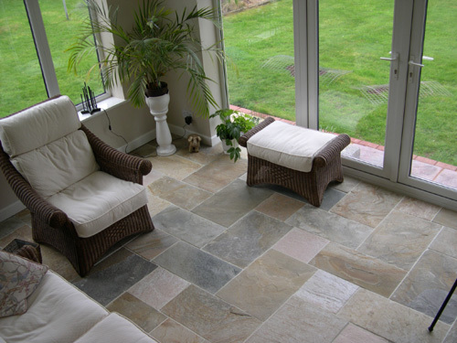
Tyles-Natural Stone
Natural Stone – comes in a variety of types, sizes, and qualities. It is costly to purchase and install. There are 5 types commonly available: limestone, travertine, granite, marble, and slate.
Stone floors are easy to maintain.
Expensive

Slide 10
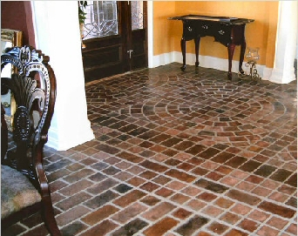
Concrete & Brick
Concrete can have a smooth or textured surface. Color can be added in powder form when mixing concrete, or painted with special paint.
Brick floors are beautiful but costly. They come in many sizes, colors, and textures, and can be used in a wide variety of patterns.

Slide 11
Floor Coverings
Floor coverings –
Surfaces placed over the structural floor. Although they are attached to the floor, they are not part of the structure.
Floor coverings include soft coverings, and resilient floor coverings.
Soft floor coverings – include carpets, rugs and pads/cushions .
They are made from manufactured or natural fibers.
Manufactured fibers include: nylon and olefin, while natural fibers include wool, cotton, sisal, and seagrass.
Soft floor coverings can cover the entire floor or portions of it.

Slide 12
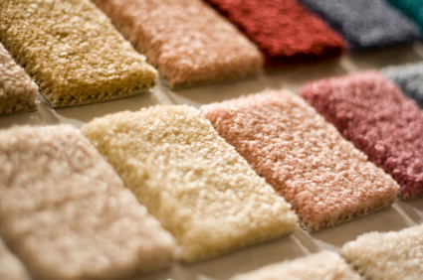
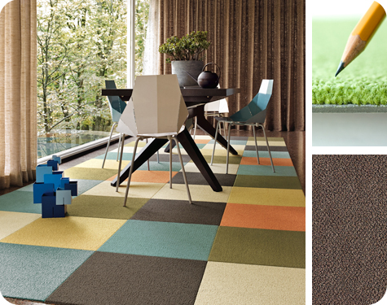
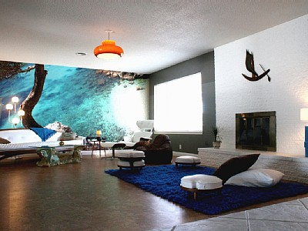
Soft Floor Coverings
Wall-to-wall carpeting – covers an entire floor, making rooms appear large and luxurious.
Room-size rug – exposes a small border of floor.
Area rugs – vary in size, but they are not as large as a room-size rug. Area rugs define areas of a room, add interest, and even serve as a focal point.

Slide 13
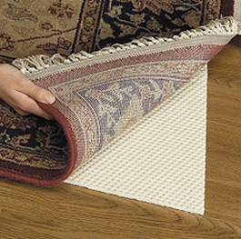
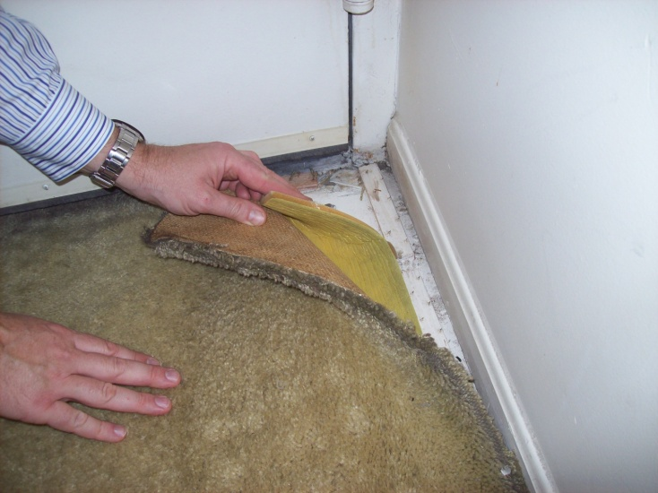
Soft Covering:
Pads/cushions:
It is used under carpeting and rugs to diminish the abrasion, increase resilience and add luxury and warmth.
Padding is made of: hair, jute, sponge or foam rubber.
The type used will depend of quality of carpet.
Check with carpet or rug’s manufacturers.

Slide 14
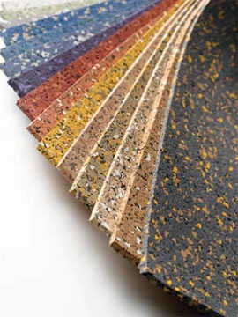
Resilient Floor Coverings
Resilient floor coverings – are floor treatments that are nonabsorbent, durable, easy to maintain, and fairly inexpensive.
They provide some cushioning for walking comfort and noise control.

Slide 15
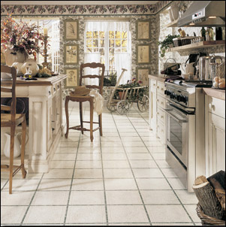
4 types of resilient floor coverings
Vinyl – are resistant to wear and stains, but abrasion can damage the surface.

Slide 16
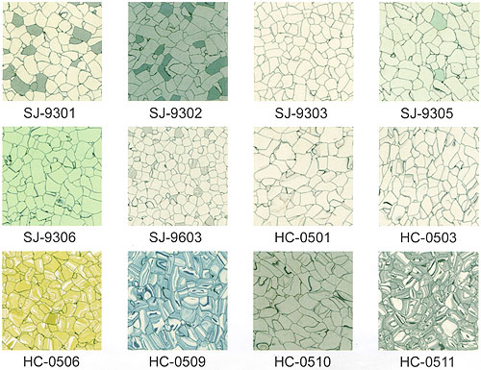
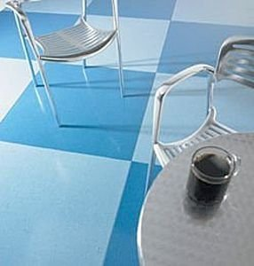
4 types of resilient floor coverings
2. Solid vinyl – are higher in quality than sheet vinyl. It is made totally of vinyl as opposed to sheet vinyl, which only has vinyl as the top layer.

Slide 17
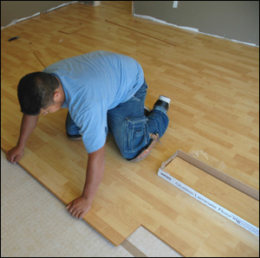
4 types of resilient floor coverings
3. Laminate – is a product made by uniting one or more layers, usually a decorative surface to a sturdy core. The final product is resistant to traffic, stains, and fading.

Slide 18
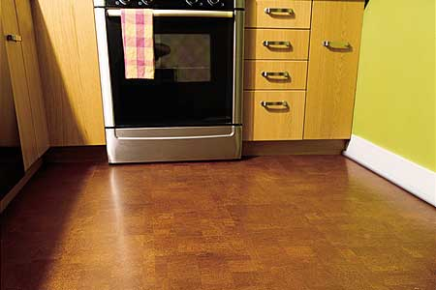
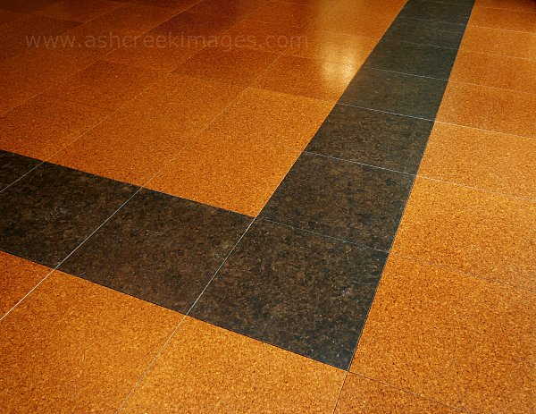
4 types of resilient floor coverings
4. Cork tile – is the woody bark tissue of a plant. This flooring must be covered with a protective coating to be water resistant, durable and easy to maintain. It is rich in appearance and is good for walking comfort and sound control.

Slide 19
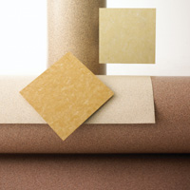
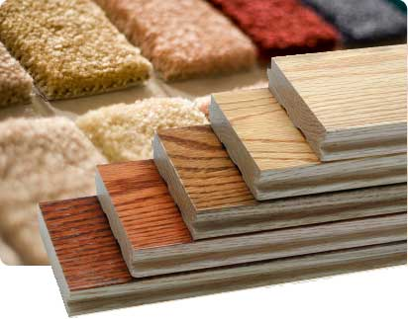
The End!

